Slide 1

DNA: Structure And Replication
Course: BIO101 (Introduction to Biology)
Part: 1 & 2

Slide 2
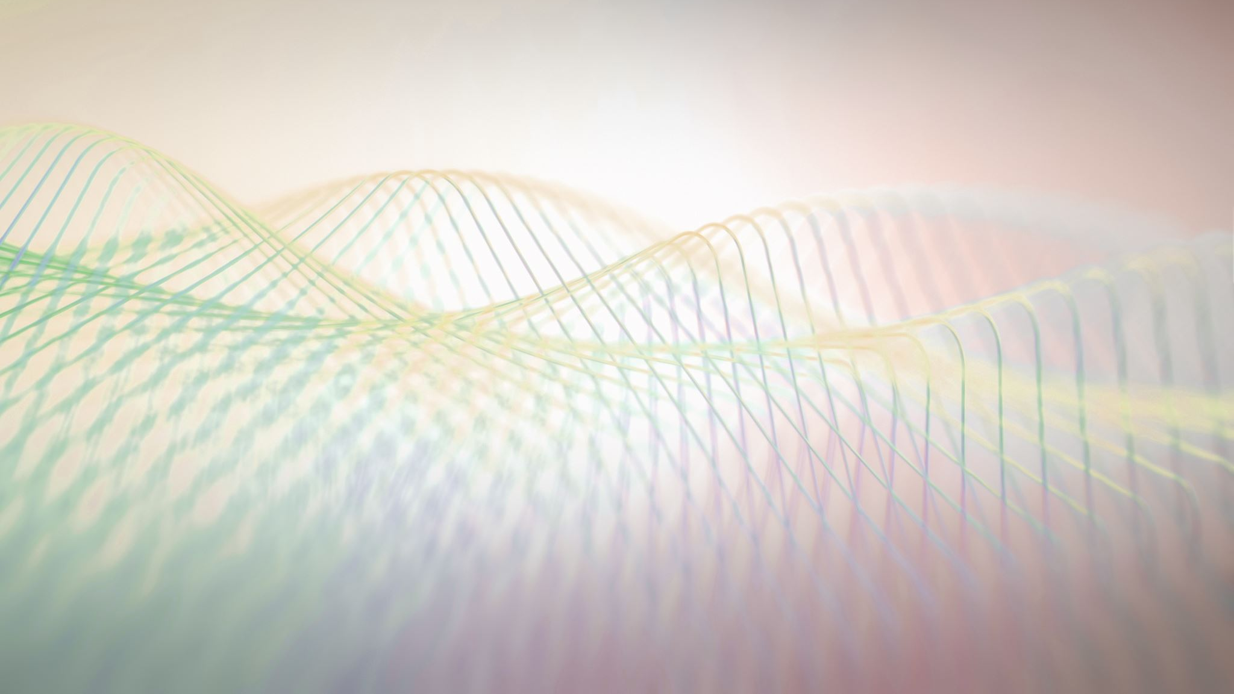
DNA: STRUCTURE & REPLICATION

Slide 3
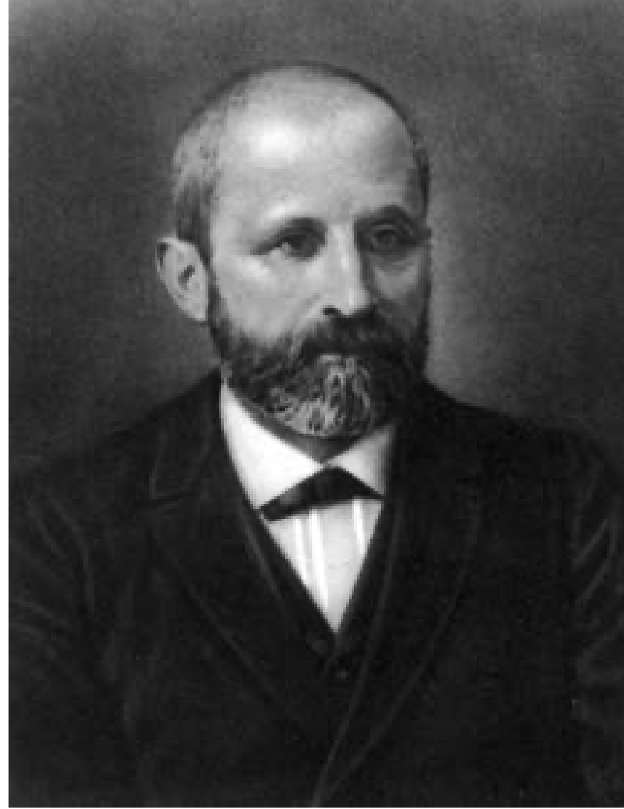
In the 1860s, Friedrich Miescher, a physician by profession, was the first person to isolate phosphate-rich chemicals from white blood cells or leukocytes. He named these chemicals “nuclein” (which would eventually be known as RNA and DNA) because they were isolated from the nuclei of the cells.
Friedrich Miescher (1844–1895)

Slide 4
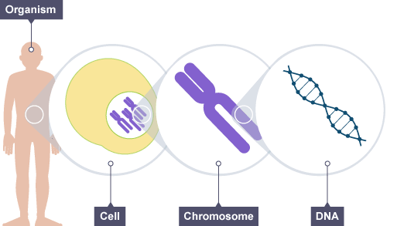
Deoxyribonucleic acid (DNA)
Deoxyribonucleic acid (DNA) is the information-carrying molecule found in all living organisms. In most animal, plant and fungal cells DNA is stored in the nucleus coiled up in thread-like structures called chromosomes.
For example, the nucleus of one of our skin cells contains about two meters of DNA, so a chromosome is a very large molecule compacted into a very small space.
The information DNA contains is the instructions that the cell uses to make proteins. Proteins play a big part in determining the characteristics of specialized cells and whole organisms, e.g., eye color, muscle mass, height and even ability to learn new skills all result from the activity of specific proteins.
Courtesy: https://www.bbc.co.uk/bitesize/guides/z2qs2nb/revision/1

Slide 5

DNA and RNA Structure
Both DNA and RNA are nucleic acids, which consist of long chains (polymers) of chemical units (monomers) called nucleotides- the building blocks of DNA and RNA.
Nucleotides are joined by covalent bonds between the sugar of one nucleotide and the phosphate of the next. This results in a repeating pattern of sugar-phosphate-sugar-phosphate, which is known as a sugar-phosphate backbone.
There are four different types of nucleotide. The part of a nucleotide that can make it different from others is called the base. The nitrogenous bases are arranged like ribs that project from this backbone.
The bases can be divided into two types. Thymine (T) and cytosine (C) are single-ring structures and called Purines. Adenine (A) and guanine (G) are larger, double-ring structures and known as Pyrimidines. In stead of thymine, RNA has a similar base called uracil (U).

Slide 6
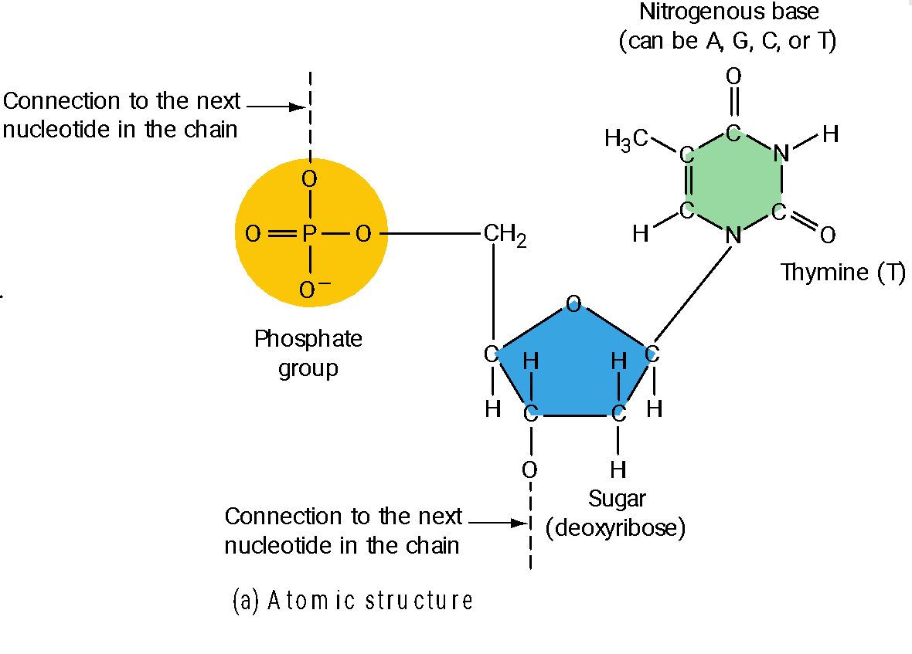
A DNA Nucleotide
A DNA nucleotide monomer consists of three parts: a sugar (deoxyribose), a phosphate, and a nitrogenous (nitrogen-containing) base.
Courtesy: Campbell Essential Biology, Pearson

Slide 7
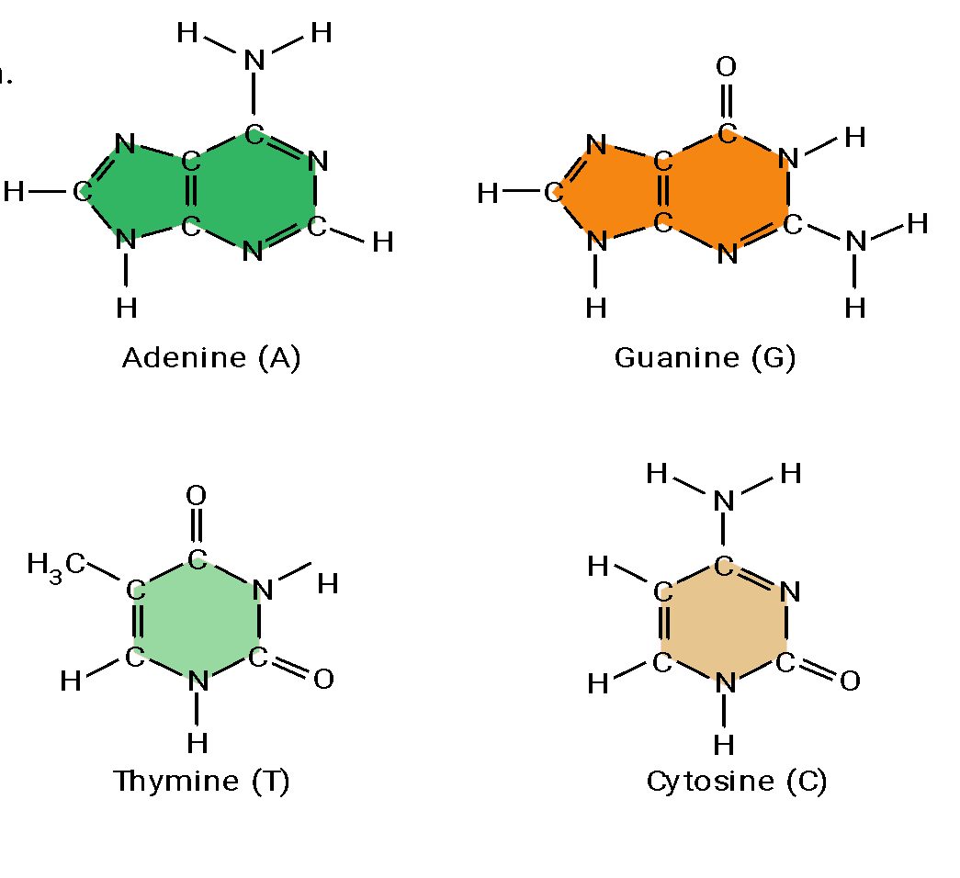
The Nitrogenous Bases of DNA
Notice that adenine and guanine have double-ring structures. Thymine and cytosine have single-ring structures.
Courtesy: Campbell Essential Biology, Pearson

Slide 8
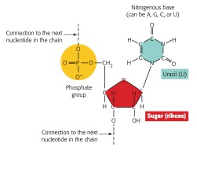
An RNA Nucleotide
The RNA nucleotide differs from the DNA nucleotide in two ways: The RNA sugar is ribose rather than deoxyribose, and the base is uracil (U) instead of thymine (T). The other three kinds of RNA nucleotides have the bases A, C, and G, as in DNA.
Courtesy: Campbell Essential Biology, Pearson

Slide 9
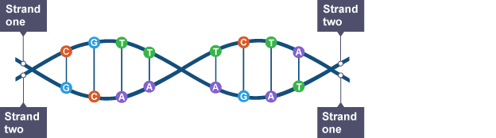

Double Helix and Base Complementary
Nucleotides are linked together to form strands. DNA consists of two strands of nucleotides twisted around each other to form a shape called a double helix.
The two strands are held together by weak bonds between pairs of bases. Only certain pairs of bases have complementary shapes that let them form bonds with each other to make the double helix.
Base A bonds with base T and base G bonds with base C. These are complementary.
Courtesy: https://www.bbc.co.uk/bitesize/guides/z2qs2nb/revision/1

Slide 10
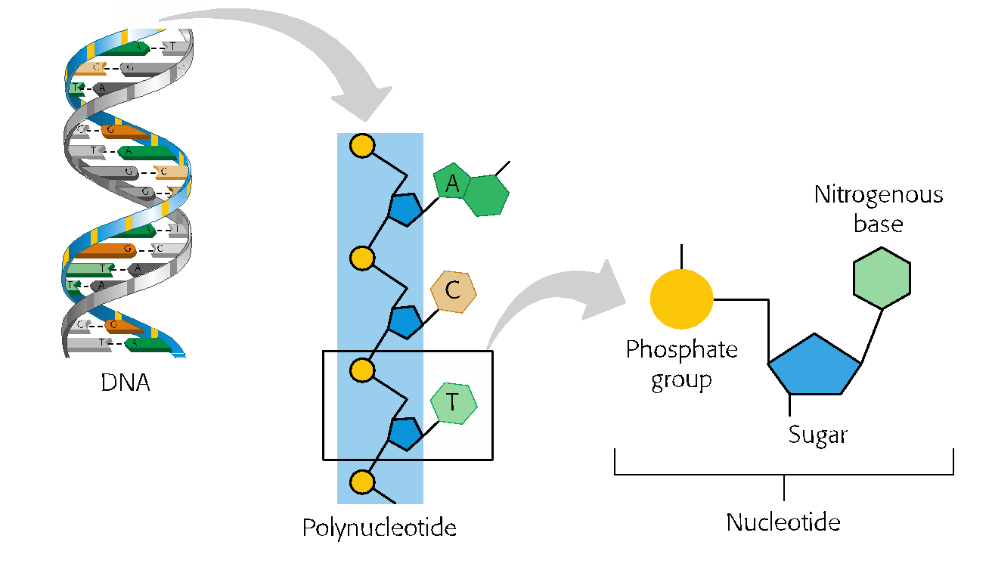
The Chemical Structure of a DNA Polynucleotide
Courtesy: Campbell Essential Biology, Pearson

Slide 11
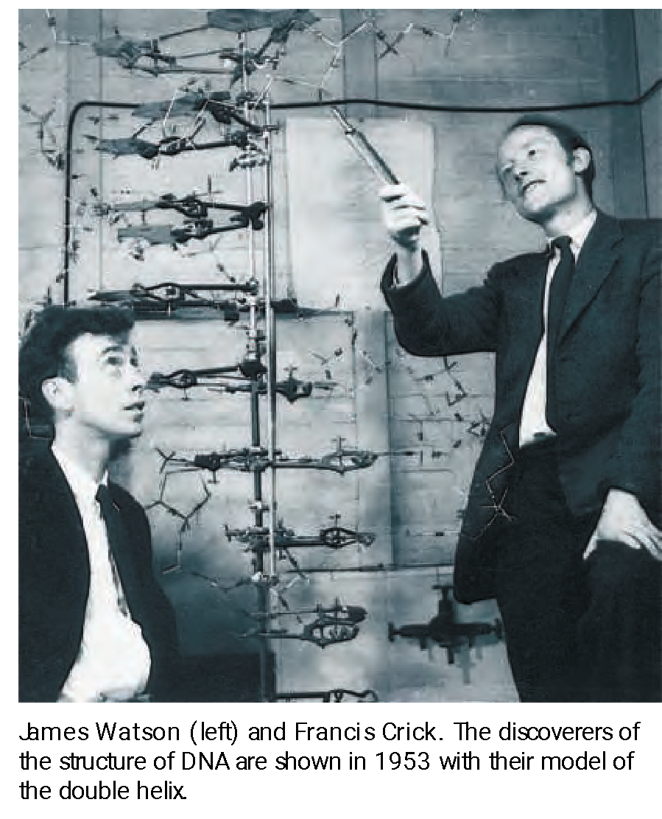
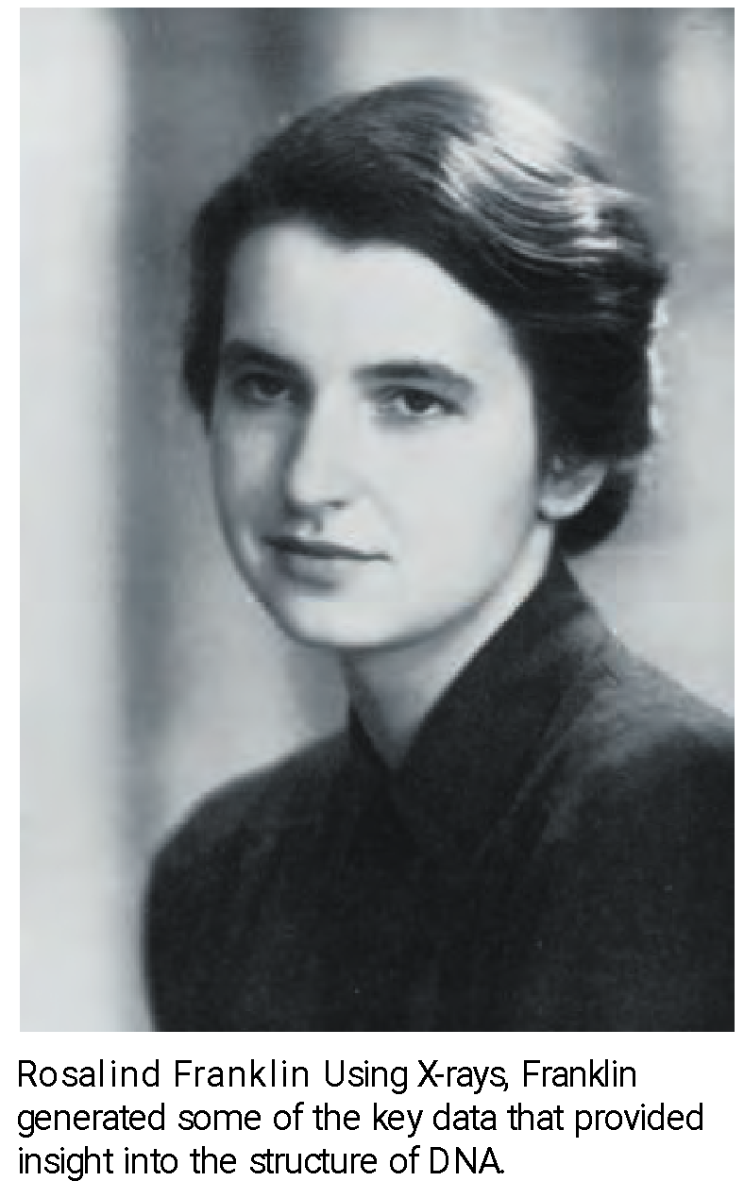
Discoverers of the Double Helix
Courtesy: Campbell Essential Biology, Pearson

Slide 12
Watson and Crick’s Model of the DNA
This model has the following major features:
Two long polynucleotide chains are coiled around a central axis, forming a right-handed double helix.
The two chains are antiparallel; that is, their C-5’- to-C-3’ orientations run in opposite directions.
The bases of both chains are flat structures lying perpendicular to the axis; they are “stacked” on one another, 3.4 Å (0.34 nm) apart, on the inside of the double helix.
The nitrogenous bases of opposite chains are paired as the result of the formation of hydrogen bonds; in DNA, only A,T and G‚C pairs occur.
Each complete turn of the helix is 34 Å (3.4 nm) long; thus, each turn of the helix is the length of a series of 10 base pairs.
A larger major groove alternating with a smaller minor groove winds along the length of the molecule.
The double helix has a diameter of 20 Å (2.0 nm).

Slide 13
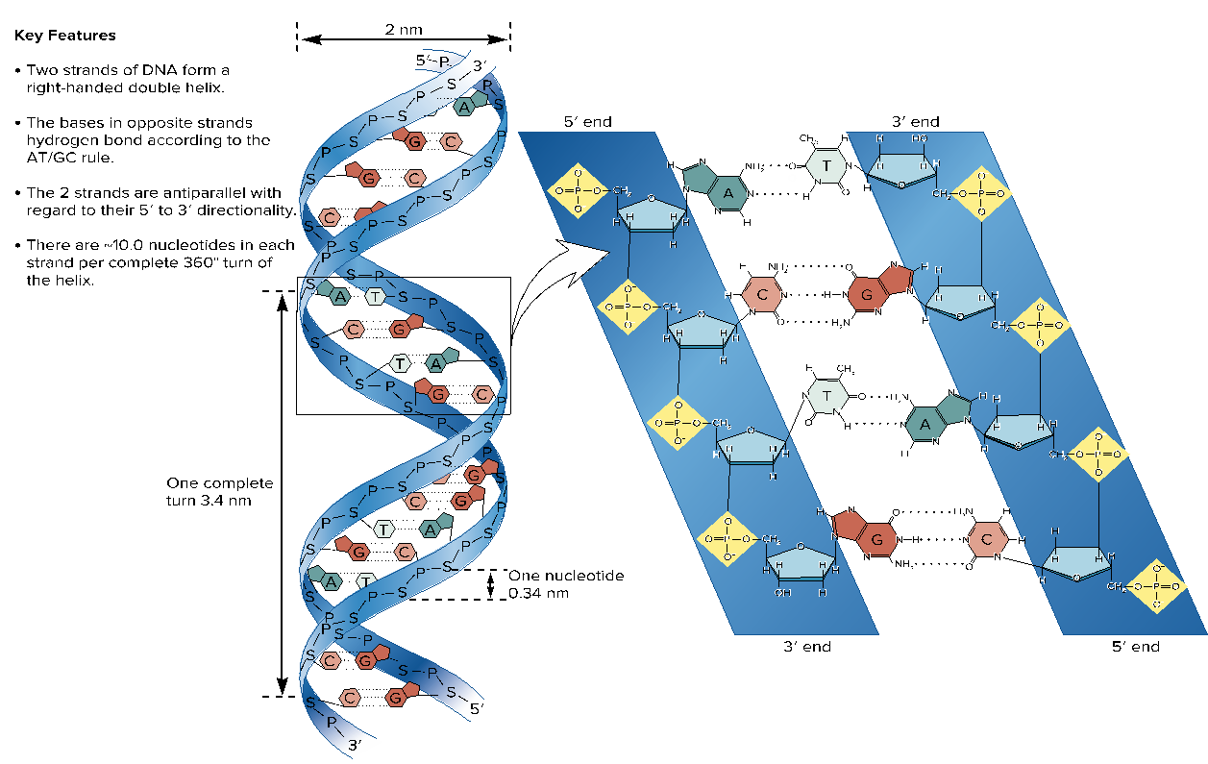
Key features of the structure of the double helix

Slide 14
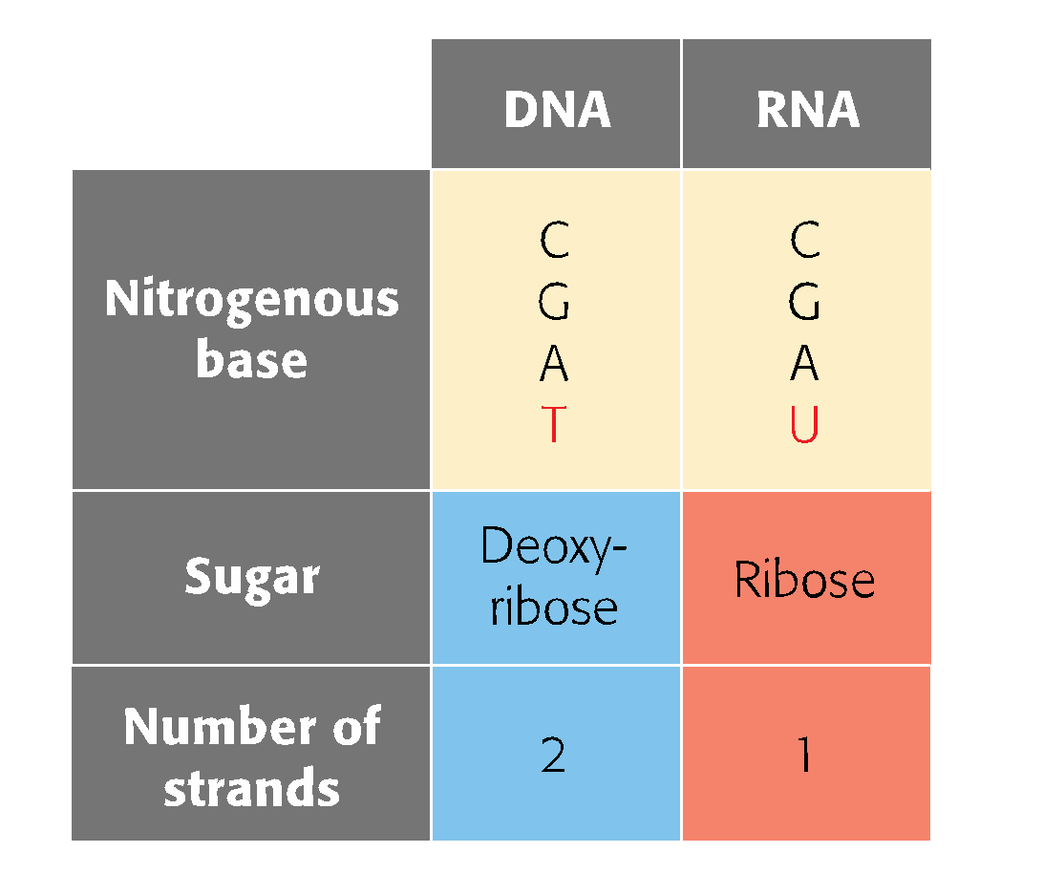
DNA Vs RNA
Courtesy: Campbell Essential Biology, Pearson

Slide 15
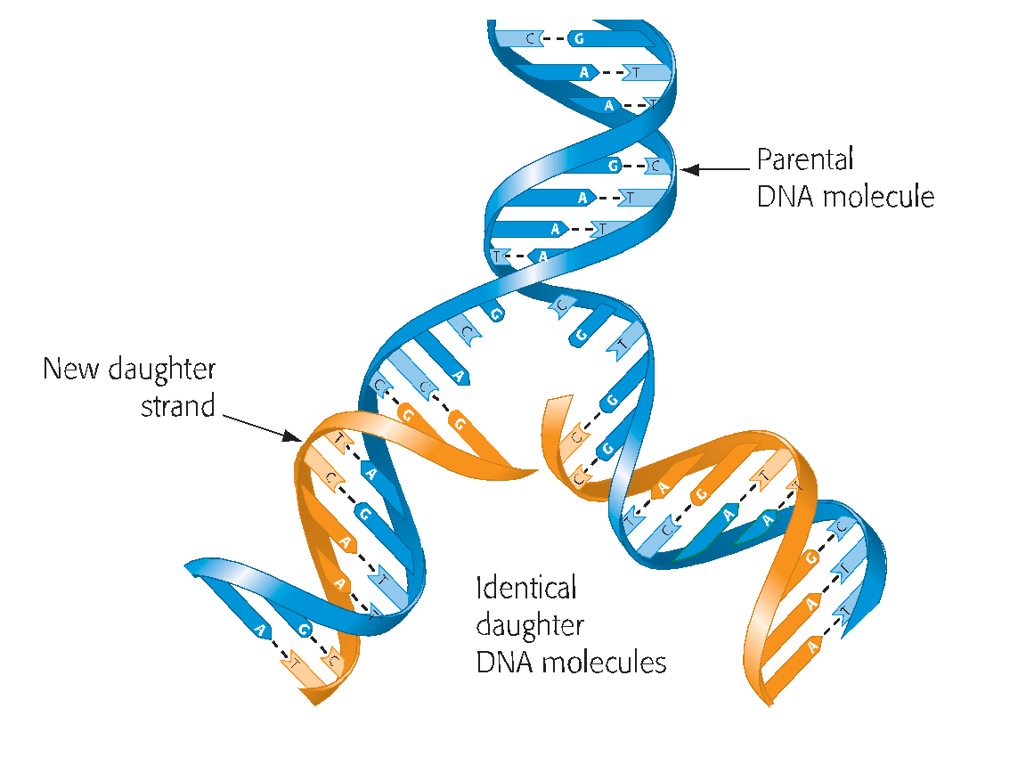
DNA Replication
The structure of DNA, with its complementary base pairing, allows it to function as the molecule of heredity through DNA replication.
Replication results in two daughter DNA molecules, each consisting of one old strand and one new strand. The parental DNA untwists as its strands separate, and the daughter DNA rewinds as it forms.
The two strands of parental DNA separate, and each becomes a template for the assembly of a complementary strand from a supply of free nucleotides.
Courtesy: Campbell Essential Biology, Pearson

Slide 16
DNA Replication (Continue)
The nucleotides are lined up one at a time along the template strand in accordance with the base- pairing rules: A pairs with T (and T with A), and G pairs with C (and C with G). For example, if one polynucleotide has the sequence AGTC, then the complementary polynucleotide in that DNA molecule must have the sequence TCAG.
The enzymes that make the covalent bonds between the nucleotides of a new DNA strand are called DNA polymerases.
As an incoming nucleotide base-pairs with its complement on the template strand, a DNA polymerase adds it to the end of the growing daughter strand.
In addition to their roles in DNA replication, DNA polymerases and some of the associated proteins can repair DNA that has been damaged by toxic chemicals or high-energy radiation, such as X-rays and ultraviolet light.
DNA replication ensures that all the body cells in a multicellular organism carry the same genetic information. It is also the means by which genetic information is passed along to offspring.
Courtesy: Campbell Essential Biology, Pearson

Slide 17
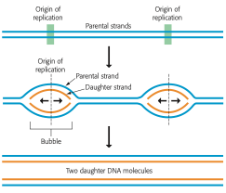
Origin of Replication
Multiple “bubbles” in replicating DNA
DNA replication begins on a double helix at specific sites, called origins of replication. Replication then proceeds in both directions, creating what are called replication “bubbles”.
The parental DNA strands open as daughter strands elongate on both sides of each bubble.
The DNA molecule of a typical eukaryotic chromosome has many origins where replication can start simultaneously, shortening the total time needed for the process. Eventually, all the bubbles merge, yielding two completed double-stranded daughter DNA molecules.
Courtesy: Campbell Essential Biology, Pearson

Slide 18
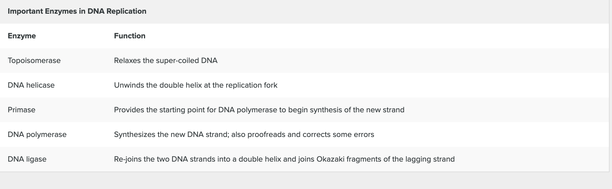

Slide 19
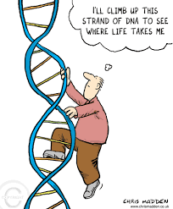
THANK YOU

